Slide 1

Project Background
Cookie Cats is a hugely popular mobile puzzle game developed by Tactile Entertainment. It's a classic "connect three" style puzzle game where the player must connect tiles of the same color in order to clear the board and win the level. It also features singing cats.
As players progress through the game they will encounter gates that force them to wait some time before they can progress or make an in-app purchase. In this project, we will analyze the result of an A/B test where the first gate in Cookie Cats was moved from level 30 to level 40. In particular, I will analyze the impact on player retention and game rounds.

Slide 2
Problem definition
As players progress through the game, they will encounter gates that force them to wait some time before they can progress or make an in-app purchase. In this project, I will analyze the result of an A/B test where the first gate in Cookie Cats was moved from level 30 to level 40. In particular, I will analyze the impact on player retention.
Data Description
The data is from 90,189 players that installed the game while the AB-test was running. The variables are:
userid - a unique number that identifies each player.
version - whether the player was put in the control group (gate_30 - a gate at level 30) or the test group (gate_40 - a gate at level 40).
sum_gamerounds - the number of game rounds played by the player during the first week after installation
retention_1 - did the player come back and play 1 day after installing?
retention_7 - did the player come back and play 7 days after installing?
When a player installed the game, he or she was randomly assigned to either gate_30 or gate_40.
Notes:
Photo by unsplash.com

Slide 3
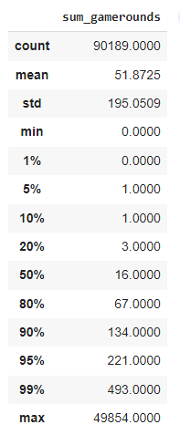
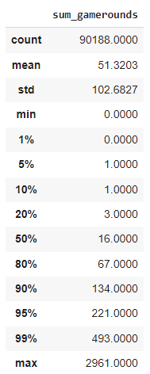
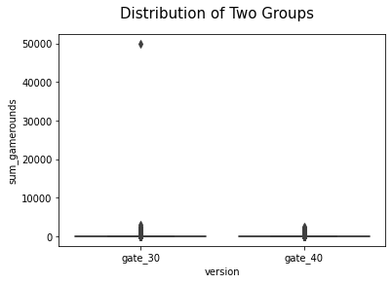
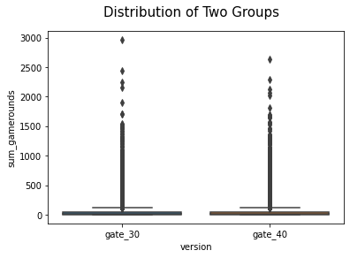
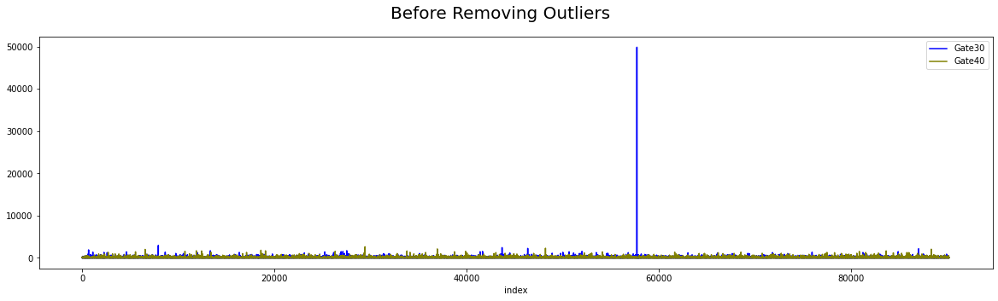
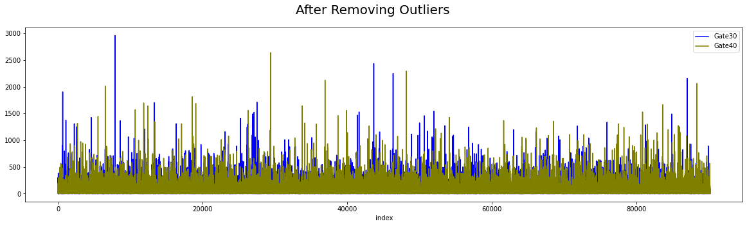
Summary Statistic
Before Handling Outliers
After Handling Outliers

Slide 4
Formulating Hypotheses
That used in this A/B Testing
Null Hypothesis
Testing Normality
Shapiro-Wilk Test
Non-Parametric Method
Mann-Whitney U Test
There is no difference between level 30 and level 40.
H0 = There is no statistically significant difference between level 30 and level 40.
Ha = There is a statistically significant difference between level 30 and level 40.
H0 = The distribution of the values of the two groups are equal.
Ha = The distribution of the values of the two groups are not equal.

Slide 5
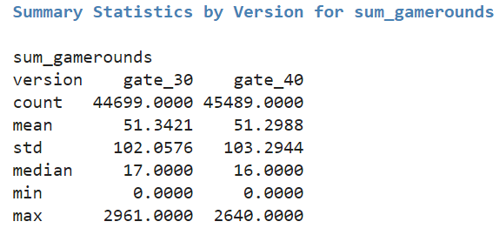
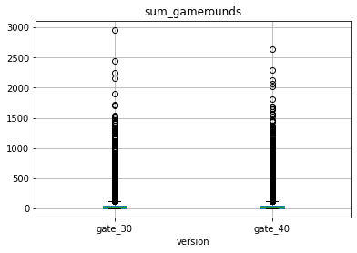
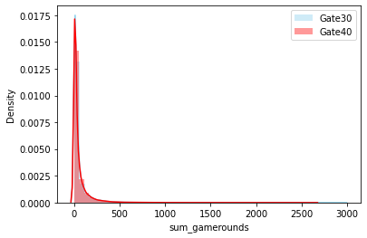
Hypotheses Testing
Notes:
Photo by unsplash.com

Slide 6
Hypotheses Testing
1. Step: Testing the Normality Assumption for sum_gamerounds
gate_30_shaphiro_p = 0.000, gate_40_shaphiro_p = 0.000
Shaphiro Wilk Test resulted as p < .05 for gate_30 and gate_40 which indicates that H0 is rejected. Accordingly distribution of sum_gamerounds values in gate_30 and gate_40 are not likely to normal distribution.
3. Step: Alternative 2 -> Mann-Whitney U Test for sum_gamerounds
u_value=1024285761.500, mannw_test_p=0.051
Mann Whitney U Test resulted as p > .05 which indicates that H0 failed to reject. Accordingly there is no significant difference between gate_30 and gate_40 in distributions of sum_gamerounds values.
Notes:
Photo by unsplash.com

Slide 7
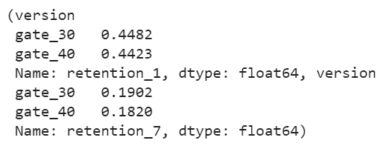
Result Interpretation
There is no significant difference between the two groups regarding moving the first gate from level 30 to level 40 for the game round. If we want to decide based on one metric, both bidding systems can be chosen, but level 30 data shows a lower dev std which can be trusted more.
We can also see which level is more profitable for player retention. Based on the data above, the average retention of 1 day and 7-days is higher when the gate is at level 30 than at level 40. This result follows the first result that level 30 data can be trusted more.
Notes:
Photo by unsplash.com

Slide 8
Google Collab
https://colab.research.google.com/drive/1WXHFbi7i8B88pID2Dw_lFwsLBm3ng6UW?usp=sharing

